Slide 1
266 Natural Language Processing
Week 13: NLP in the Real World

Slide 2
This Week
Goals
Understand the difference between “research” and “practical application” of NLP
Review and draw together material from entire class

Slide 3
Peeking Ahead
Week 1: Introduction
Week 2: Text Classification
Week 3: Language and Context
Week 4: Pretrained Transformers
Week 5: Text Generation Models
Week 6: Machine Translation
Week 7: Question Answering & Summarization
Week 8: Linguistic Representation
Week 9: Entities and Linking
Week 10: Embedding-based Retrieval
Week 11: Multimodality in NLP
Week 12: ML Fairness and Privacy
Week 13: NLP in the Real World
Week 14: Project Presentations

Slide 4
The Plan
Structure of Class
Project Check in
Research vs. Practice
Putting it all Together

Slide 5
Project FAQ
Page limit: 4-6 pages. "I don't have enough time to write a shorter paper!"
The best projects have been (well) within the word limit. Short and to the point, with interesting analysis.
If you go a bit over because of a reference section? Sure. Image captioning project with lots of fun examples in an appendix? Great!
Certainly don't have any hard rules "6 pages and one word? zero!", but be respectful of our time! :)
Presentations
Focus on the interesting parts of your problem. Know your audience. (Do not waste time explaining what BERT is.)
Probably you want to put some slides together, rather than just present the report pdf.
Aim for 5-7 minutes. Usually it takes a little longer than you expected. Then a few people will have questions.
If you are a cross-section group, you will only present in one section. Express your preference in this Google Project Submission Form.

Slide 6
Project FAQ (continued)
Reports
Follow the instructions on the GitHub Project Page to submit (you must complete the Submission Form)
Only one submission per project.
Make sure you have something interesting to say, not just a table of throwing models at the wall.
Due April 14 (Sunday) at 11:59 PM.
Do not submit them late. 10% penalty for each day late.

Slide 7
Feedback Please!
End of semester feedback is now open!
https://course-evaluations.berkeley.edu
We are always working on changes to improve the class. If you have ideas, please feel free to *also* reach out if your ideas don’t fit the feedback template.

Slide 8
Research vs. Practice
NLP in the Real World

Slide 9
Three-way Tradeoff
Latency: ?
Capacity: ?
Utility: ?
Notes:
Anywhere you can delay for a little while for a batch job to handle it. E.g. Deciding if a new social media post is spam. You can fall back on some easy heuristic (e.g. limit reach of the new post) while a batch job catches up running a transformer model soon after. So long as the batch job keeps up in aggregate within some number of minutes, …
Web search gets better, but with diminishing returns as you score more document candidates and as you score them with more sophisticated models.

Slide 10
Three-way Tradeoff
Latency: the time it takes for the system to respond
Capacity: the amount of money it takes to run the system
Utility: is the system doing something … useful? (in NLP/ML, this is usually in the form of some top line model performance metric)
Give an example of when you might sacrifice latency for reduced capacity costs.
Give an example of where utility and latency compete.
Notes:
Anywhere you can delay for a little while for a batch job to handle it. E.g. Deciding if a new social media post is spam. You can fall back on some easy heuristic (e.g. limit reach of the new post) while a batch job catches up running a transformer model soon after. So long as the batch job keeps up in aggregate within some number of minutes, …
Web search gets better, but with diminishing returns as you score more document candidates and as you score them with more sophisticated models.

Slide 11
In theory, one might matter more
Users are impatient.
A couple hundred of milliseconds is the difference between happiness and abandonment
Batch jobs are less so.
Raw throughput (and associated cost) are primary
In both cases, assumption is you can keep up in aggregate.

Slide 12
In practice: both are often broken
Latency and capacity are somewhat coupled, especially for in-memory computational tasks (e.g. matrix multiplication).
If a request is entirely CPU bound and takes 10s to complete, then you can only run 0.1 request/second on a single core.
Want more? Bring up more servers. (Pay more money.)
When was the last time you waited 10s for a search result?

Slide 13
e.g. social media feed composition
Want:
diversity
statefulness
expand beyond echo-chamber
interesting
Need: understanding of the current content, past content consumed, and the user.

Slide 14
e.g. social media feed composition
What can we do to speed this up?
Original plan
1M candidates
Expensive
Scoring
10M requests
1M x 10M = 10T expensive scoring operations

Slide 15
Idea: Tiered retrieval
Revised plan
Lightweight (Best 100)
1M candidates
Expensive
10M requests
100 x 10M = 1B expensive scoring operations

Slide 16
Idea: Tiered retrieval
Lightweight retrieval and scoring needs to be:
Lightweight.
Minimal impact to end to end quality.
Minimal complexity (both systems and to reason about)
What’s one example of lightweight retrieval we’ve already seen earlier in the course?
Regarding end to end quality and complexity, why might that previous approach be especially suitable?
Any other ideas on how to retrieve candidates more efficiently?
Notes:
Two tower
It is trained on exactly the same training data and objective as the expensive model, so the whole system is aligned well end-to-end. If you change the objective, it changes up and down the entire stack.
Other ideas
Depending on the kind of feed, storing candidates in a way that you consider the most globally/locally interesting ones first (independent of the user’s interest) and only keep considering candidates until you have a decent sized pool to go into full scoring (“decent sized” can be a tuning knob to trade off how much quality you lose end to end vs. capacity & latency).
Can also shard by topic / source, to ensure a diversity in the candidate pool that comes back

Slide 17
Sharding & Replication: not just for storage!
Some requests need more compute than can be fit on a single machine within the latency deadline.
Problem: laggard shards!
P(all shards complete by deadline) =
P(shard complete by deadline)^{num_shards}
Idea: Backup requests.
Notes:
Why lagging? Stuck/broken, some shard overloaded, …
Old idea, but also works in ML: https://static.googleusercontent.com/media/research.google.com/en//pubs/archive/44875.pdf

Slide 18
Your labels aren’t what your product needs
Not in your logs / label set:
User happiness
Product / market fit
Things you never served / had labeled
Before your NLP model can help, you need a set of metrics.
What are the kinds of problems you might have optimizing for a proxy for each of these missing facets?
Notes:
Say you optimize for clicks in your social media feed: “10 ways to cook a hamburger… do you know them all?”
From last week, optimizing for positive hiring decision => fairness issues in hiring process are now systemic.
No guarantees your model does anything reasonable with examples far away from the data manifold upon which it was trained.

Slide 19
What’s a (good) metric?
A good metric is something someone cares about!
Every metric (even the good ones) are broken have blind spots.
Secondary metrics help ensure you are achieving the main objective in the way you hope.
Think of some common metrics products you use may be using in the background.
What issues might there be?
What secondary metrics might mitigate them?
(Usually these secondary metrics are a modeling opportunity to maximize the main metric while controlling for the secondary)
Notes:
newsfeed daily active users
racy / violent / misinformation
Human rater judgements on what you’re showing users
(Can maximize active users subject to constraints on the content mix)
Focus group happiness scores about the customizability of some product
Product gets super complicated, impossible to test all the setting combinations
Do users actually use settings? The ones who do, do other happiness metrics show a lift after they do? Are there common patterns of settings (allowing you to vastly simplify the testing surface)

Slide 20
Types of metrics
Product
How many users find value?
Corpus / candidates quality
Matching / retrieval / scoring
Infrastructure
Latency (ms)
Capacity ($ / request)
Reliability
Notes:
F_1 versus F_beta

Slide 21
Risk mitigation
It would be strange to be called a data scientist and never look at any data.
Look at what your model is doing in the real world
Identify failure modes
Add secondary metrics to see how often they occur
Fund projects to tackle (potentially sacrificing some primary metric)
Why is it almost always necessary to sacrifice the primary metric?
Related: Why must you explicitly think through the primary / secondary metric tradeoff?
Notes:
If you’re optimizing for active users (or whatever), and now you want to launch a project that restricts that optimization in some way (reduce clickbait), it’s quite likely that the unconstrained operating point is no longer available (especially since you’re seeing that the model at that operating point is having failures that your project is impacting, those items aren’t theoretical!)
If the spam team is punished every time a spam email makes it through to the exec’s inbox, they have an easy solution: mark every incoming message as spam.
—-------------------------

Slide 22
Example: Secondary metric in action
Problem:
You want to eliminate some class of posts in a feed
Solution:
Train a classifier, P(bad_class | post content).
Use PR curve to select an operating point

Slide 23
Measure it
Metric:
Classifier’s ROC-AUC.
Train on 90% of the examples.
Measure on a random 10% test set.
What else do you need to think about?
Notes:
Don’t use a random Train / Test split! Deciding that you don’t want sensational celeb news showing up may result in your classifier learning that “Johnny Depp” is bad. Which is great if everyone keeps posting about that, but you want your model to work on future examples! A better split would be train on “older” spam examples and test on “newer” to get a better notion of how the model will perform on new examples.
Constructing a test set on even newer data a few months down the line and running the old model against it allows you to see the drop in performance over time (initial test set vs. updated test set). This can give you an indication of how often you might want to retrain the model…. And whether it’s worth tackling the complexity of productionizing / automating the retraining.
Can extend beyond temporal - train on one set of users / publishers / etc, test on the others…. That way the model doesn’t memorize something about e.g. new york times or the GCN youtube channel that doesn’t generalize to new candidates by new users / publishers.

Slide 24
Models should play in sandboxes
Don’t trust your model.
With any system, there are limits beyond which something has obviously gone wrong.
It’s insurance: pay some expected value in exchange for predictions on rarer events.
What’s an example?
Notes:
Diversity:
Posts from only a single influencer / publisher
Showing the same post repeatedly

Slide 25
Training with a model in the loop
Back to our bad-post classifier.
You’re super successful!
Great! You’ve eliminated everything your high performing model predicts is spam.
What problems are you worried about when you refresh the model?
Notes:
How do you iterate / retrain?
You’ve eliminated all the things that are spammy. But now they don’t show up in production, so you don’t have examples of them anymore.
You’ve eliminated all the things that you thought were spammy but weren’t! You don’t have examples of these misunderstood good examples, either!

Slide 26
Training/serving skew
Candidates in the corpus evolve.
As a result:
Their BERT embeddings therefore change.
Their labels can change too!
You want to generate training data for the last month of candidates.
What might you want to think about?
Notes:
When you’re generating candidates, you need the candidates as they were at the time they were actually showing up in the product, not what the signals settled down to be a month later!
One solution is to log all the signals in the moment and generate training data from there.
One downside to doing this is that adding a new feature can be really slow (add the feature, wait a month for examples to trickle in)
… so still need to do this join to see if there’s sign of life.

Slide 27
Paper Peeks/Recent Advances/Challenges
NLP in the Real World

Slide 28
Paper Peeks
Red Teaming Language Models to Reduce Harms:
Methods, Scaling Behaviors, and Lessons Learned
FINE-TUNING ALIGNED LANGUAGE MODELS COMPROMISES SAFETY, EVEN WHEN USERS DO NOT INTEND TO!

Slide 29
Putting it all Together
The Whole Course

Slide 30
Putting it all Together
Week 1: Introduction
Week 2: Text Classification
Week 3: Language and Context
Week 4: Pretrained Transformers
Week 5: Text Generation Models
Week 6: Machine Translation
Week 7: Question Answering & Summarization
Week 8: Linguistic Representation
Week 9: Entities and Linking
Week 10: Embedding-based Retrieval
Week 11: Multimodality in NLP
Week 12: ML Fairness and Privacy
Week 13: NLP in the Real World

Slide 31
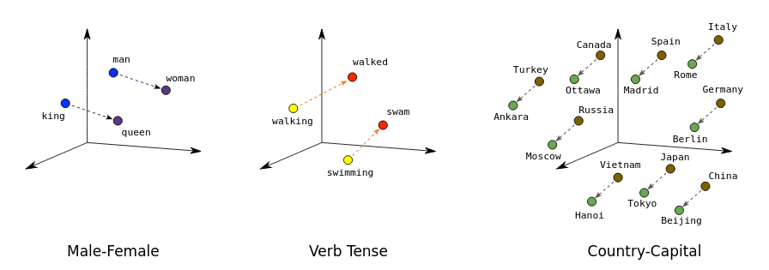
NLP Review
‘Why neural nets’ in the first place?
What do we see here? Why is it significant?
What is the Embedding Matrix?
Image Source: developers.google.com

Slide 32
NLP Review
What is the role of an encoder in a seq2seq architecture?
What sort of tasks are best done using a seq2seq architecture?
What exactly is a transformer? Is it just another term for an Encoder block; if not how is a transformer different..?
Is BERT synonymous with transformers or is transformers a general term for models like BERT..?
What are the differences between pre-training and fine-tuning?

Slide 33
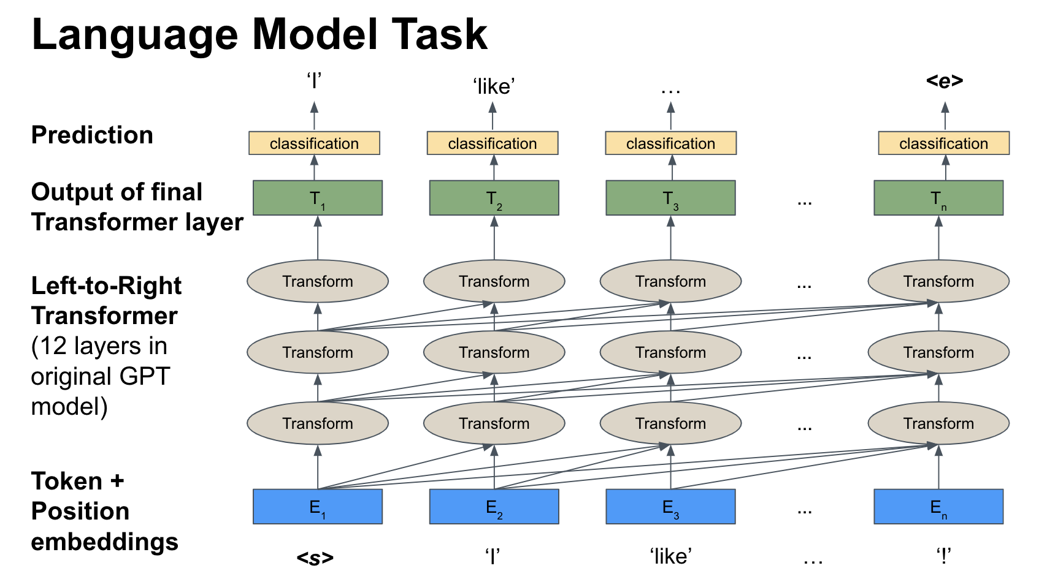
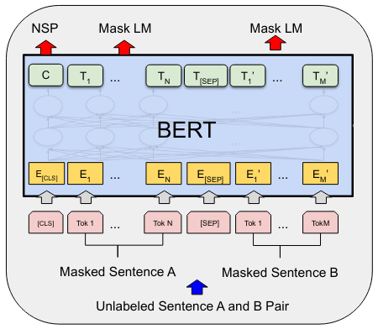
NLP Review - GPT vs. BERT
Image Source (edited): Devlin et al., BERT: Pre-training of Deep Bidirectional Transformers for Language Understanding, https://arxiv.org/pdf/1810.04805.pdf
Questions:
What are the differences between both models?
How does that relate to the training tasks?
Notes:
The fat cat sat on the fence and meowed.
The fat cat sat on the → fence

Slide 34
NLP Review
What characterizes the goal(s) of a few-shot model?
What are the similarities between abstractive summarization and generative question answering?
When would you use beam search?
How does a two tower model help us address the shortcomings of some fully connected models?
Describe the coreference resolution problem? What is a technique to approach it? How does it relate to entity resolution?
What’s the critical contribution of CLIP?

Slide 35
Next Week: Your Presentations
End of This Week (Sunday):
Projects Due
April 14th!

Slide 36
Thanks for a great class!

